Slide 1


Roadmap Speakers
Atmikha Jeeju · Anushka Dave
Aperture Partners · Indiana University

Slide 2

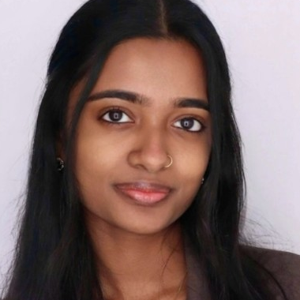
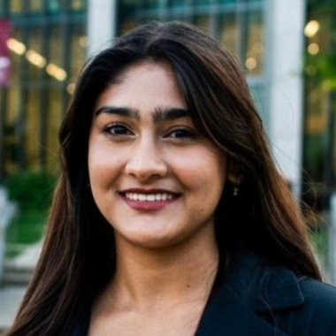
GUEST SPEAKERS
Meet the speakers
Atmikha Jeeju
Anushka Dave
M.S. Information Systems · Kelley
B.S. Informatics · IU Luddy
B.S. Computer Science, AI specialization
Business and cybersecurity minors
Previously at ServiceNow
Previously at EY
Notes:
Atmikha: https://www.linkedin.com/in/atmikha ; https://www.linkedin.com/posts/atmikha_indianauniversity-artificialintelligence-activity-7459790567535706112-l9kt ; Photo: user-provided LinkedIn screenshot
Anushka: https://www.linkedin.com/in/anushka-dave ; Photo: user-provided LinkedIn screenshot

